Slide 1
LLM-Elicted Bayesian Predictor
Presenter: Seongwon Yun
© 2025 Hanwha Life

Slide 2
Contents
Goal
Limitation of Naive LLM Predictor
Eliciting Bayesian Priors
Idea
Validation
Dashboard
Research Ideas

Slide 3
References
- Capstick, A., Krishnan, R. G., & Barnaghi, P. (2025). AutoElicit: Using large language models for expert prior elicitation in predictive modelling (ICML 2025).

Slide 4
Goal
- Use LLM for prediction.
- Incorporate expert knowledge.
- Provide potentially useful information to the user (e.g. executives).

Slide 5
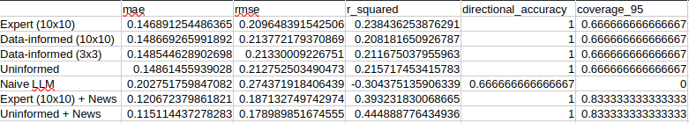
Limitation of Naive LLM Predictor

Slide 6
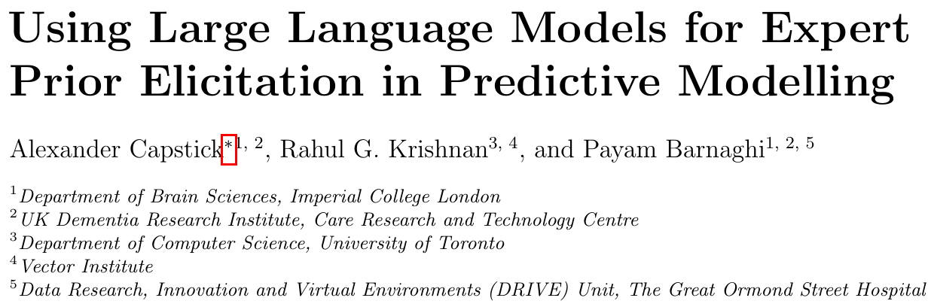
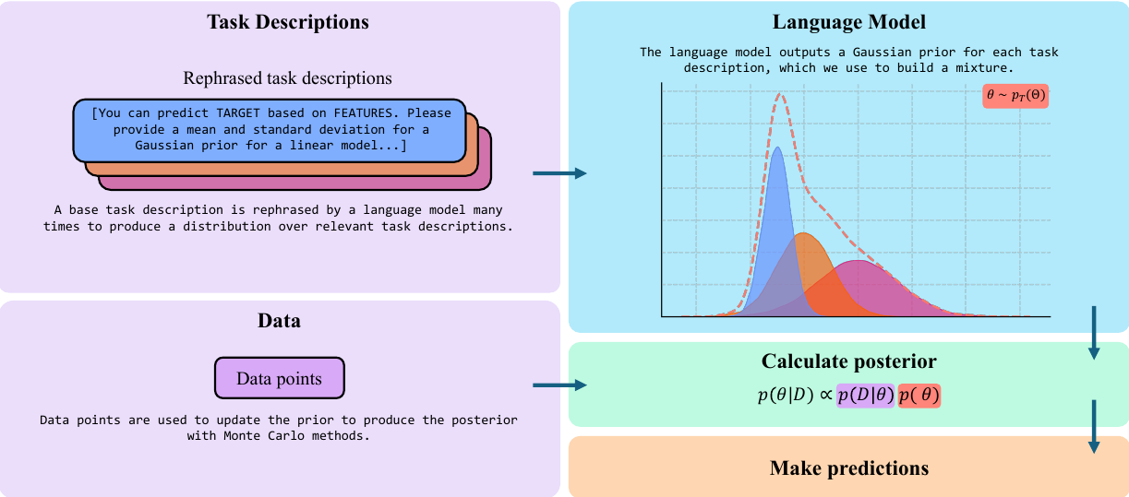
Eliciting Bayesian Priors

Slide 7
Idea
Create an agent such that
- through conversation, choose predictor variables.
- inject expert priors, or use uninformed priors, or (with a well-knowledgeable agent) elicit priors from LLM.
- use Bayesian linear regression to fit the data.
As for prediction,
- Use the user’s scenarios to generate (point or distributional) predictor values. Alternatively, recent data could be utilized instead.
Benefits:
- Explainability to executives
- Scenario analysis
- Obviously better than naive LLM prediction + LLM interaction

Slide 8
Idea
Novelty:
- Multivariate prior generation.
- Prediction based on expert scenarios (z|beta ~ N(expert_prior, tau))
- News as a latent variable approach with LLM-generated priors.

Slide 9
Validation
Data Used:

Slide 10
Validation

Slide 11
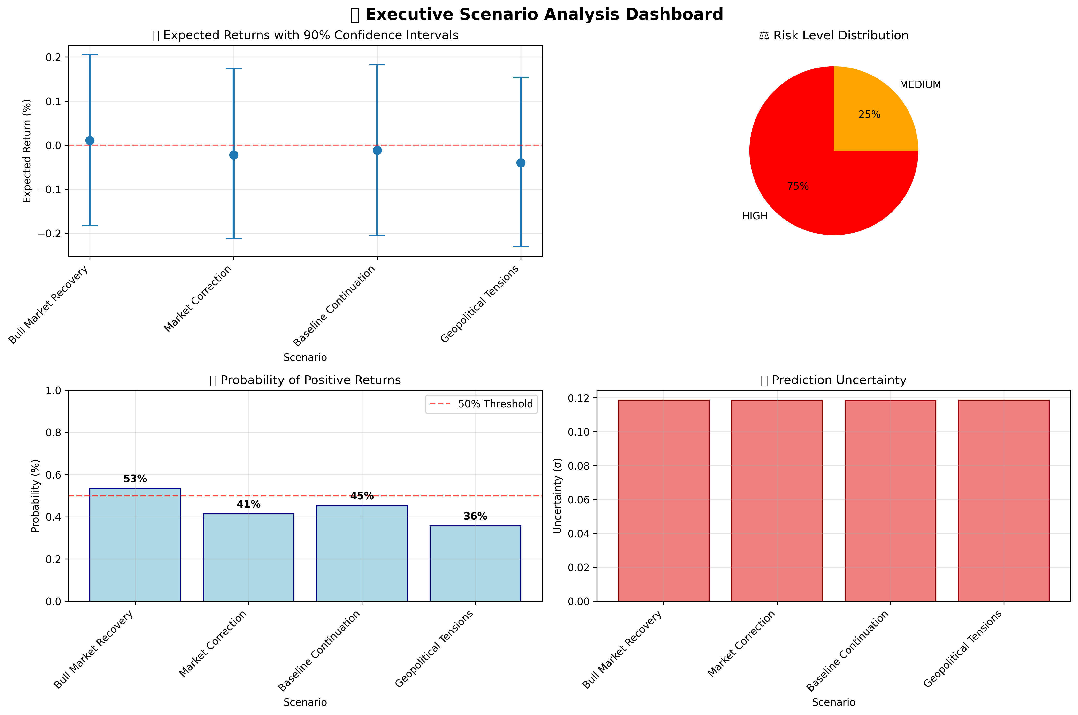
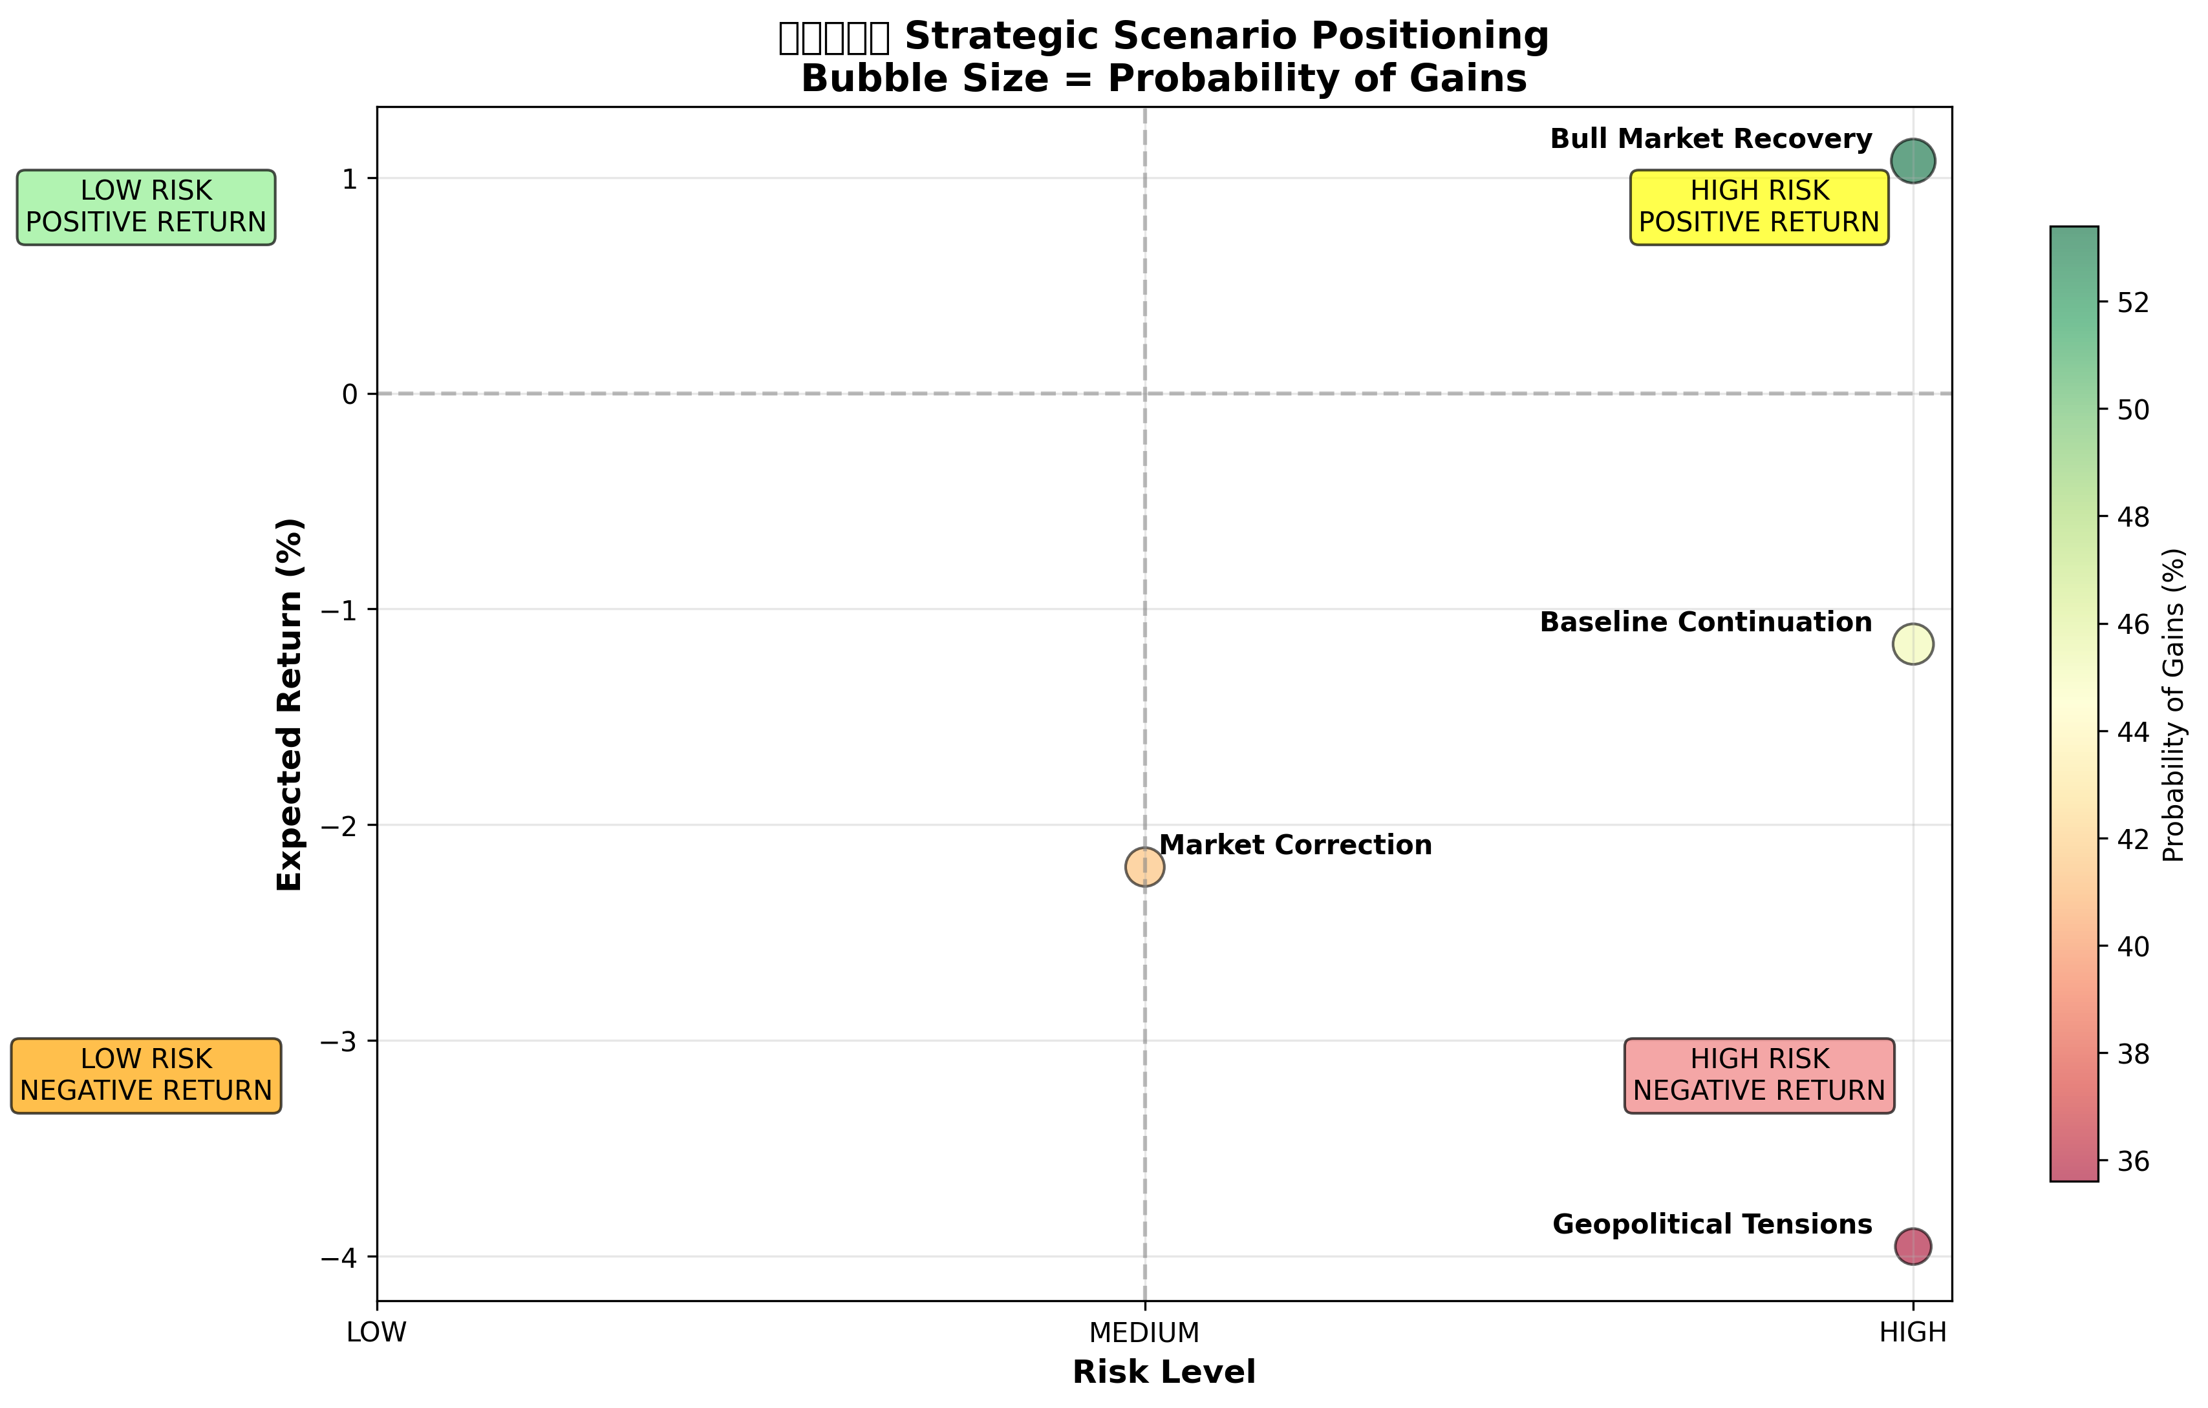
Dashboard

Slide 12

Idea: Incorporating Expert’s Opinions
Predictor variable distribution:
Different beta relationship offered by experts:

Slide 13
Idea: Incorporating Expert’s Opinions
Or, regarding expert opinion as another data source,
Then the posterior becomes

Slide 14

Idea: News as a Latent Variable
Y = X\beta + \epsilon
Y = X\beta + delta_t + \epsilon
Generate mixture priors for each delta_t based on the collected news:
Q. Macro factors already explain the systematic part of Hanwha Solutions' return. Based on the news below, state your Gaussian PRIOR (mean, std) in percentage points for the idiosyncratic return α_news this month.
Likelihood: p(y | beta, sigma, delta) = prod_t p=(y | beta, sigma, delta_t)

Slide 15

Idea: News as a Latent Variable
Now we want to predict y*. We derive the mixture distribution for delta* as well, then

